Slide 1
Sentiment Analysis for Hinglish Code-mixed Tweets by means of Cross-lingual Word Embedding
Presented By –
Rittick Mondal (214101041)
Anamitra Mukherjee (214101007)
Souvik Gorai (214101055)
Prosenjit Biswas (214101038)

Slide 2
Introduction
Sentiment analysis is a technique to classify the sentiment or emotion of an sentence.
Here sentiment analysis is done on the “code mixed tweets”.
For that we have explored both “mono-lingual” as well as “cross-lingual” embedding on the given code mixed tweet data.
It investigates the use of embedding for a sentiment analysis task for Hinglish Tweets, viz. English combined with (transliterated) Hindi.

Slide 3
Code mixing vs code switching
Code-mixing refers to intra-sentencial mixing of linguistic entities
Ex:- Mai ice-cream khane jaa raha tha suddenly mai Ram ko dekha.
Code switching refers to inter-sentencial mixing of linguistic entities
Ex:- Mai raste se jaa raha tha. Suddenly I saw Ram.

Slide 4
What is word Embedding?
Word embedding is a type of word representation such that allows words with similar meaning to have a similar representation.
It is a technique where individual words are represented as real-valued vectors in a predefined vector space.
Here we use two types of word embedding -
1. Monolingual word embedding
2. Crosslingual word embedding

Slide 5
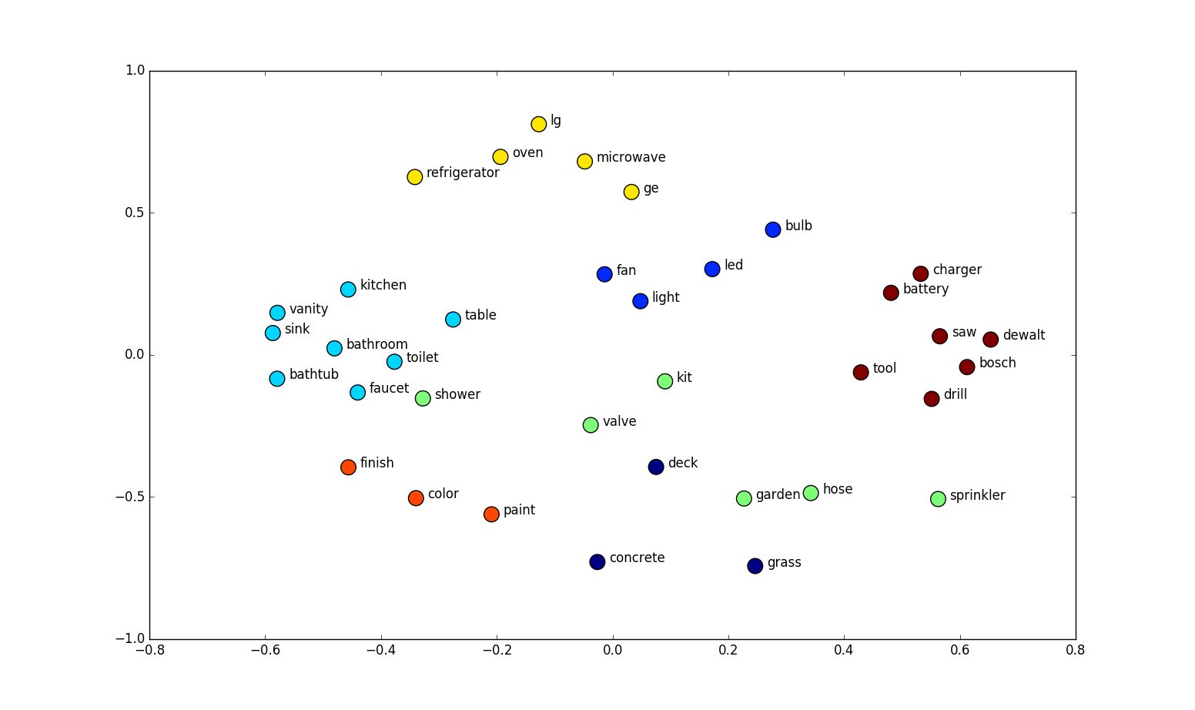
Monolingual Embedding
Monolingual embedding projects words from only one single language to a vector space.

Slide 6
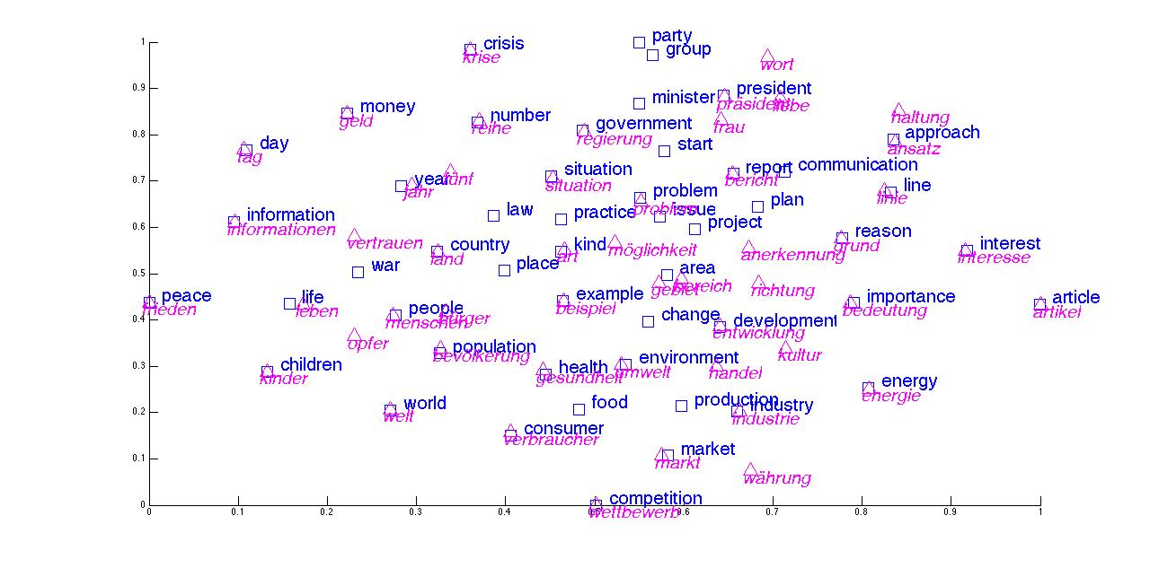
Cross lingual embedding
Cross-Lingual embedding methods jointly learn embeddings of words of more than one language in a shared space
Cross-Lingual embedding help in knowledge transfer between languages

Slide 7
Challenges
Models are normally trained on monolingual data, but here we have cross lingual data.
As a result none of the NLP tools which is very effective for sentiment analysis is does not cope with code-mixed data.
Not only code mixing, but also use English phonetic typing to write Hindi words, instead of using the Devanagari script.
We will discuss models to solve this problem.

Slide 8
Experimental Setup
Baseline Monolingual Systems: Models exclusively trained using monolingual embedding on English data.
Supervised Classification: Models incorporating cross-lingual English transliterated Hindi embedding using vecmap.
Our Approach: Models trained with already pre trained XLM-R BERT model on multiple languages.

Slide 9
Baseline Model
In the baseline model we use Monolingual word embedding on English data.
FastText will be used for word embedding

Slide 10
Supervised Classification
Cross-lingual embeddings used as input to the models for sentiment analysis task.
Here the embedding technique used for this is – VecMap.
Assumptions for VecMap is that two words having same meaning in different languages will have the same distribution

Slide 11
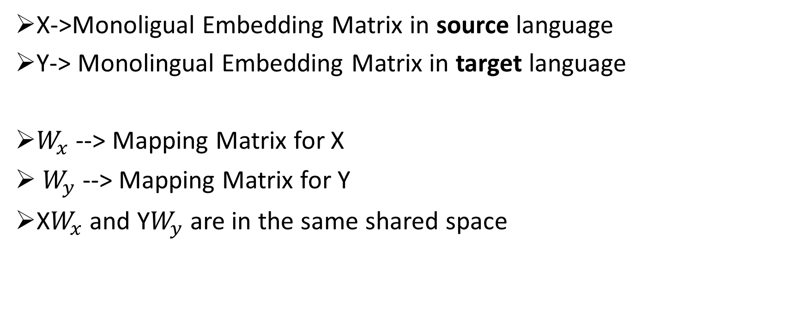
VecMap
X->Monoligual Embedding Matrix in source language
Y-> Monolingual Embedding Matrix in target language
$W_{x}$ --> Mapping Matrix for X
$W_{y}$ --> Mapping Matrix for Y
X$W_{x}$ and Y$W_{y}$ are in the same shared space

Slide 12
Model Architecture
Bi-LSTM Encoder used with 4 layers
Pre-trained crosslingual or monolingual embeddings were fed to the LSTM, the size of the hidden layer was 128
The whole system was trained with Cross-Entropy Loss optimized with Stochastic Gradient Descent (SGD).
Each of the models was trained and evaluated with 5-fold cross-validation, and an internal 5-fold cross-validation was performed on the training partition for hyper-parameter optimization.

Slide 13
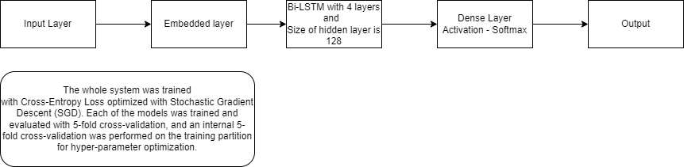
Model Architecture (Cont.)

Slide 14
Limitations of proposed models in research paper
VecMap method performs better than all other methods only when initialized with seed dictionary (referred to as vecMap seedDict) but it’s not always possible to obtain seed dictionary for non-lexically overlapping languages, for e.g., English and Russian have only 24% overlap of vocabularies.
Learning cross-lingual mapping matrix W, has following assumptions - Source and target languages have distribution about the same mean, embeddings of source and target languages are zero-centered, which may not reflect in the dataset.

Slide 15
Our Proposal
Our proposed model for improvement is XLM-RoBERTa.
XLM-R, uses self-supervised training techniques to achieve state-of-the-art performance in cross-lingual understanding.
BERT works on semantic meaning of a sentence.
BERT is much faster as compared to Bi-LSTM, which is described in the paper.
Our model XLM-R, is 2-20% faster than BERT. That is the reason for us choosing this model.

Slide 16
Our Proposal (Cont.)
XLM-R is pretrained multi lingual model.
XLM-R was trained on 100 languages.
It was trained of 2.5 TB of publicly available common crawl dataset.
XLM-R works on the semantic meaning of the sentence.
After extensive experiments and ablation studies, it’s shown that XLM-R is the first multilingual model to outperform traditional monolingual baselines that rely on pretrained models.

Slide 17
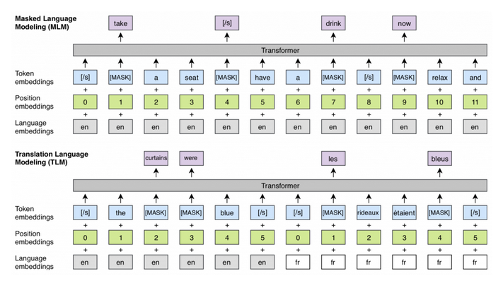
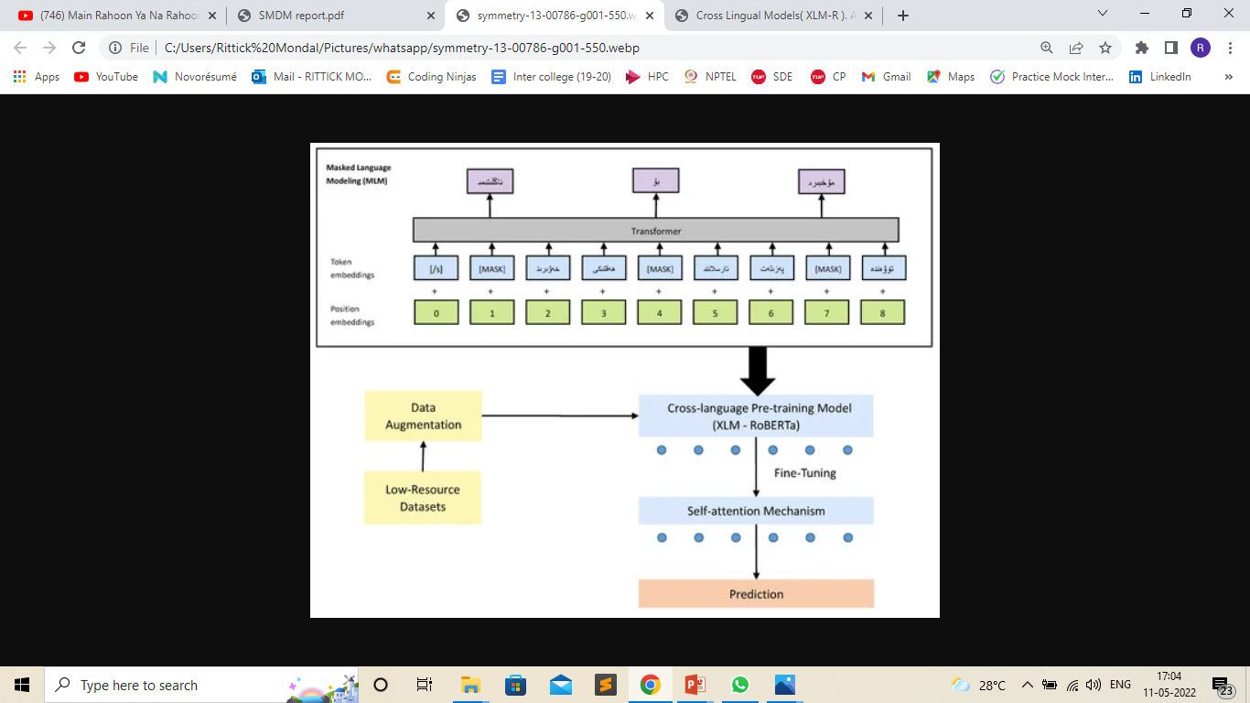

Model Architecture

Slide 18
Outputs
Below are the observed f1-scores for the various models we have tried.
Here we only have considered f1-score as evaluation metric as its consistent with the given paper.

Slide 19
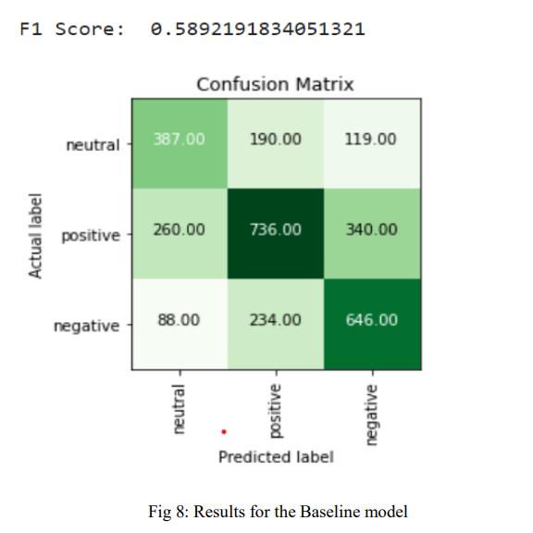
Outputs (Cont.)

Slide 20
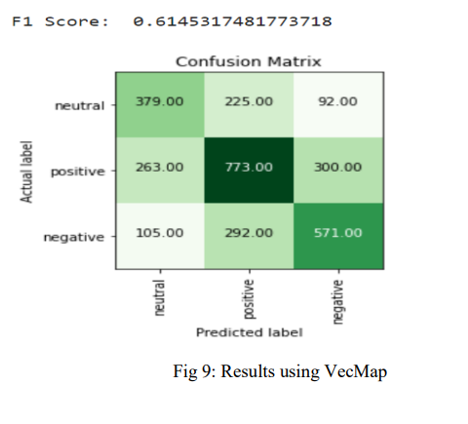
Outputs (Cont.)

Slide 21
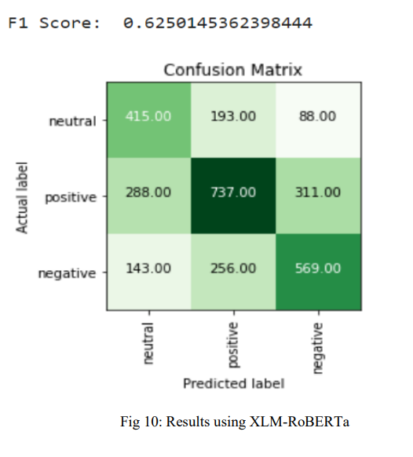
Outputs (Cont.)

Slide 22
Observations
It can be noted that the SeedDict VecMap approach consistently outperforms other types of cross-lingual embeddings.
While for the supervised experiments, the cross-lingual embeddings do not outperform classical embeddings by a large margin, there are small improvements which can be accounted for by the fact that we can use both English as well as code-mixed embeddings to classify a sentence, whereas only one of those can be used at a time in standard monolingual approaches.
As expected, our proposed model gives the best performance among the consider models.

Slide 23
Future Work
As of now for these kind of challenging problems XLM-Roberta provides state-of-the-art (SOTA) solution. So, in future we can tackle this problem from a different direction.
Also, we can play around with how the word embeddings are created and see how it affects our results.

Slide 24
THANK YOU !!!

